Slide 2
High Standards Philosophy
Notes:
Facilitator:
If this is the first-time participants are hearing about the Doc B Leadership Academy introduce the Academy. This is a great opportunity to build the “why” behind the “what” of leadership development based on the philosophies and values of Clovis Unified (script available in resource folder). If this is not the first time briefly review the purpose of the Leadership Academy.

Slide 3
We believe in high standards in Clovis Schools.
“We believe competition is an ingredient of high standards and an important motivational tool. We recognize three level of competitions.”
Doc’s Charge
Notes:
Script: Tier I, II, III
Facilitator:
In Doc’s Charge he spends a lot of time discussing the three levels of competition. We are going to delve into each of those levels to discuss why they are important to student success. Ask participants to read this portion of Doc’s Charge. You may call on audience members to read section, choral read, or read to them. As an individual think about the statement “we believe in high standards in Clovis schools. What does this statement mean to you? What is your role in maintaining high standards in CUSD. Does anyone know the three levels of competition?
Answer: 1) against yourself, 2) specialty areas, 3) group
Ask for volunteers to share their thoughts.
Discussion Points:
In small job alike groups discuss one or more of the following questions (facilitators choice).
101 - Why is competition an ingredient of high standards? Provide examples to explain your thinking.
201 - What do high standards look like in practice? Who or what is responsible for determining that a high standard has been met?
301 - What role does high standards play in preserving the district’s quality? How do we determine the quality of the district.
After groups finish ask each to share one of their answers and examples.

Slide 4
Students learn to compete against themselves.
“First, we want you to make sure that all of our students learn to compete against themselves; that’s the toughest competition of all.”
Doc’s Charge
Notes:
Script: Tier I, II, III
Facilitator:
The first level of competition is to compete against yourself. To get better tomorrow than you are today. Ask participants to read this portion of Doc’s Charge. You may call on audience members to read section, choral read, or read to them.
Discussion Points:
In small groups discuss one or more of the following questions (facilitators choice):
101 – Even though Doc’s Charge talks about kids a lot of it can apply to adults, as well. What are some ways that you compete against yourself? Share with your group.
201 - What does it look like to compete against yourself? Explain when this is important. Provide examples.
301 – Why is competing against yourself the toughest competition of all? Use examples to explain your thinking.
After everyone is done ask each group to share one of their examples.

Slide 5
Students compete in specialty areas.
“Second, we want you to encourage our students to compete in specialty areas to help them build their strengths and overcome their weaknesses because that’s the way they get jobs and that’s the way they have to perform in life.”
Doc’s Charge
Notes:
Script: Tiers I, II, III
Facilitator:
Doc believed that competition served as a motivational tool, especially for children. The second level of competition is to compete in specialty areas. Please read about the second level of competition from Doc’s Charge. Facilitator may read or choose someone to read.
Discussion Points:
In small groups of 3 discuss one or more of the following (facilitators choice).
101 – List examples of specialty areas available to students in CUSD? Are there others we should offer? If so, what would you recommend?
201 – How does competition build upon your strengths? How does it help you overcome your weaknesses? Use specific examples to explain your answer.
301 – Have you or your children ever competed in a specialty area? If so, share with the group and discuss what you learned from the experience.
After everyone is done ask each group to share one of their examples.
.

Slide 6
Students work in groups and compete in groups.
“Third, we want you to teach our students to work in groups and to compete in groups because we think that students who can’t work in groups are going to have trouble in tomorrow’s world.”
Doc’s Charge
Notes:
Script: Tiers I, II, III
Facilitator:
Today we hear a lot about the importance of soft-skills in the job force, like the ability to collaborate with others. As Janet Young would often say, “Doc was an educational genius.” Just think 60 years ago this was a core value of our district. Ask participants to read the third level of competition. Popcorn read, read altogether, or facilitator may read.
Discussion Points:
Participants may remain in small groups to discuss one or more of the following (facilitators choice).
101 – Why is it important to work and compete in groups? Think about your site and/or department how do you work in groups? How do you compete? Provide specific examples.
201 – Fifty years ago, Doc said that students who can’t work in groups are going to have trouble in today’s world? Is this statement still true? Explain your thinking.
301 – Doc applied his philosophies to children. Do you think they apply to adults, as well? Explain why or why not. Provide specific examples.
After everyone is done ask each group to share one of their examples.

Slide 7
High Standards Values
Doc’s Charge
We believe in high standards in Clovis schools. We believe competition is an ingredient of high standards and an important motivational tool. We recognize three levels of competition. First, we want you to make sure that all of our students learn to compete against themselves; that’s the toughest competition of all. Second, we want you to encourage our students to compete in specialty areas to help them build on their strengths and overcome their weaknesses, because that’s the way they get jobs and that’s the way they have to perform in life. Third, we want to you to teach our students to work in groups and to compete in groups because we think that students who can’t work in groups are going to have trouble in tomorrow’s world.
Competition does not start with schooling. Competition starts with little children just wanting to play – to catch or hit or kick a ball. Eventually, they learn a few skills and all of a sudden one of them looks at the others and says hey, let’s keep score. Now they’re interested in winning and losing, which is mostly what life’s all about.
While you are working with our children in Clovis we want you to remember the heart of the Clovis program: We want you to teach students to win with class and to lose with dignity. But we also want you to teach them that there is a lot more to being a winner than the final game score. We want you to teach them to root for their team to win, not for their other team to lose. We want you to teach our kids what to do when they lose. We want you to get them off their duffs and get them back in the fight. Don’t you let them give up. And if we can teach them not to be quitters by the time they finish the twelfth grade in the Clovis schools, they will probably make it through life.
Our philosophy is very simple: A fair break for every kid. We believe the schools and the students belong to the people. If our community wants their children to read, write, do arithmetic, sing, dance, play in the band, or compete in forensics – whatever our community wants, we are going to do – but we’re going to do it first class.
“We believe in high standards in Clovis Schools.” - Doc
When something is broken, fix it fast, fix it well, and fix it right.
Build and maintain first class facilities.
Students learn best when they are proud of their schools.
If we are going to do it, we are going to do it first class.
We are too poor to buy cheap.
Notes:
Script: Tiers I, II, III
Facilitator:
Today’s philosophy is High Standards. There are six values that reflect this philosophy. Each value will be discussed during our time together. Facilitator may read, popcorn read, or ask a participant to read the screen.
Values
“We believe in high standards in Clovis Schools” is a value statement we attribute to Doc Buchanan. The other five values are based on the collaborative effort of all employees and reviewed annually as part of our strategic plan.
When something is broken, fix it fast, fix it well, and fix it right.
Build and maintain first class facilities.
Students learn best when they are proud of their schools.
If we are going to do it, we are going to do it first class.
We are too poor to buy cheap.
Ask participants to turn to a neighbor and share one value that resonates with them and explain why. Allow 5 minutes for sharing (facilitator’s choice).
Ask for volunteers to share the value they selected and why.
Facilitator models, sharing their choice and why.
As you read each value ask for a show of hands as to who selected it. (just a point of interest) Facilitator can comment on which value was selected most often.
Example: I am a leader of a school. I consider build and maintain first class facilities a key value because this is the first impression of the quality of my school students, parents, and community members see as they drive past or enter school grounds.

Slide 8
High Standards Video
Notes:
Script: Tier I, II, III
Facilitator:
In today’s video we are going to hear current and former leaders talk about various aspects of the philosophy High Standards.
Please listen for the value statements. You have a graphic organizer (available in resource folder) to record who talked about each statement, what was said and what resonated with you. You will need this information as we work through today.
Values
“We believe in high standards in Clovis Schools.” Doc
If we are going to do it, we are going to do it first class.
Students learn best when they are proud of their schools.
We are too poor to buy cheap.
Build and maintain first class facilities.
When something is broken, fix it fast, fix it well, and fix it right.

Slide 9
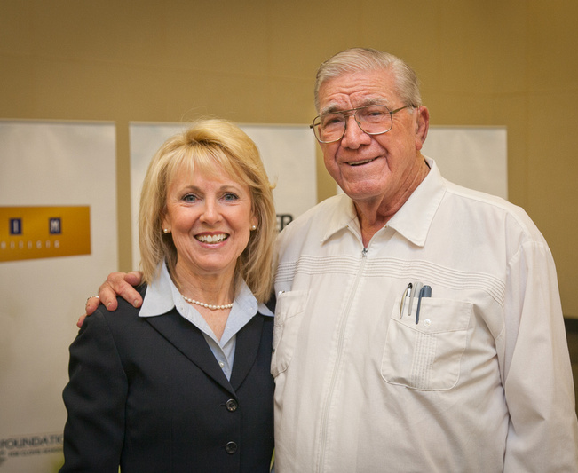
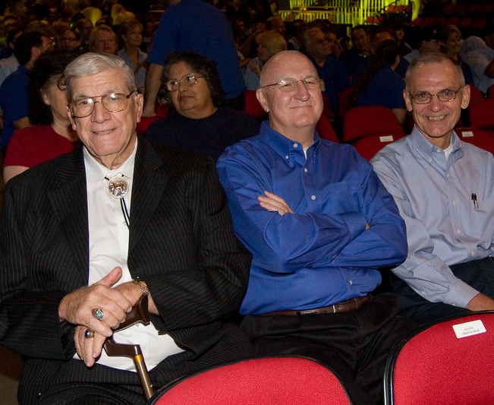
Leadership is appearance, attitude and skills; but most of all character and values.
Janet Young & Doc
Doc, Walt Buster, Terry Bradley
Notes:
Script: Tier I, II, III
Facilitator:
We have had some amazing Superintendents in Clovis Unified during the past 60 years. On the screen you see Dr. Janet Young with Doc Buchanan. The second photo is taken at General Session. It includes Doc Buchanan, Dr. Buster, and Dr. Bradley. Today we are going to discuss the high standards philosophy and values related to it. We will discuss how our mentors and role models teach us about high standards. Before we share examples of our role models let’s take a minute to read about our first Superintendent, Dr. Floyd B. Buchanan. Please read page 4, Doc Who? of the book Leadership Philosophies of the Clovis Unified School District. (available in resource folder)
After reading page 4 ask participants to shout out words or phrases that describe Doc (homespun, visionary, hire the right people, high expectations) Repeat a few.
In these pictures you see former Superintendents. Each of these individuals believed in high standards and took the time to mentor others. Tell participants they will be asked to share the name of one of their mentors and discuss the characteristics that made them an outstanding leader.
Ask participants to organize themselves in groups of three. Discuss one or more of the following questions (facilitator’s choice).
101 – Who was your mentor and what did you learn from them? Be specific.
201 – What did your mentor do that demonstrated high standards? Be specific.
301 – What is something you continue to do today because of your mentor?
As facilitator you should model the process.
At the end do a quick whip around the room asking participants to name their mentor.

Slide 10
End of Part I
Notes:
Facilitator:
Depending on your time allocation and the audience you have several options.
The PowerPoint is designed for you to use the slides you choose in any order.

